Slide 1
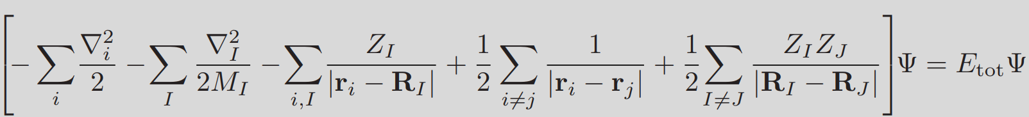
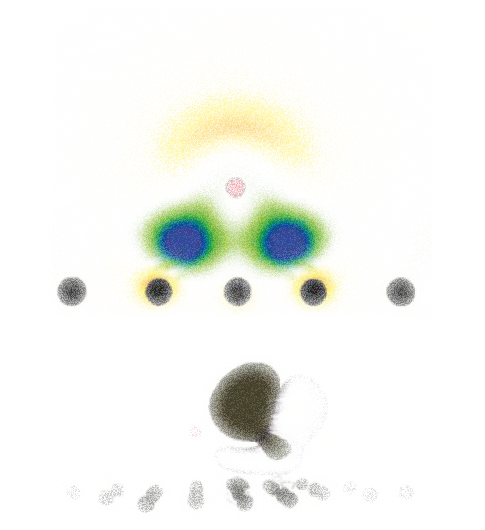
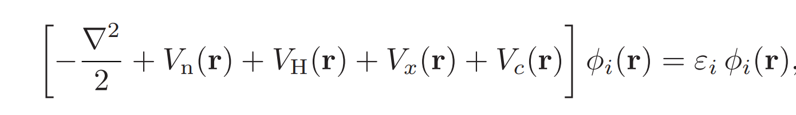
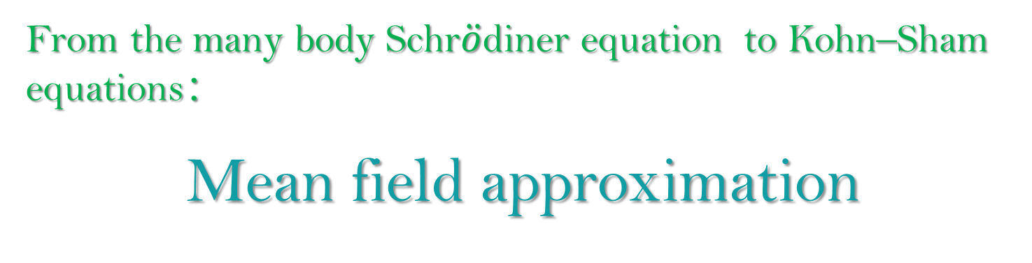
Density Functional Theory
From the many body Schr$\ddot{o}$diner equation to Kohn–Sham equations：
Mean field approximation
Summary
Magnetic
Structure
Electronic
Junfei Ding 09-Sep-2020

Slide 2
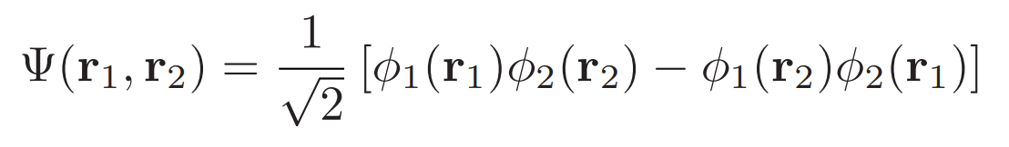
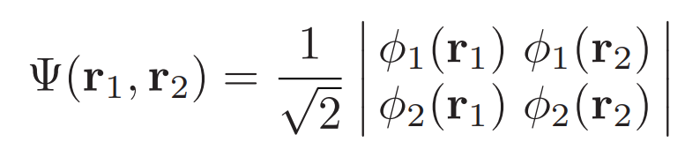
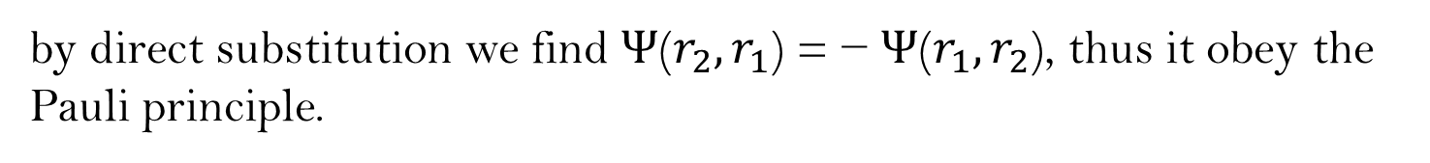
Exclusion principle
If
by direct substitution we find Ψ($r_{2},r_{1}$) = − Ψ($r_{1},r_{2}$), thus it obey the Pauli principle.
Summary
Magnetic
Structure
Electronic
A compact way of writing the above eqn is by using a matrix determinant:
which is referred to as a Slater determinant

Slide 3
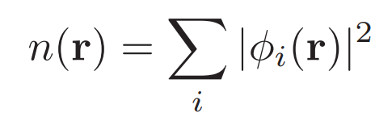
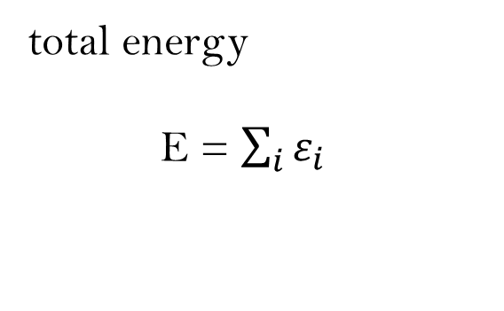
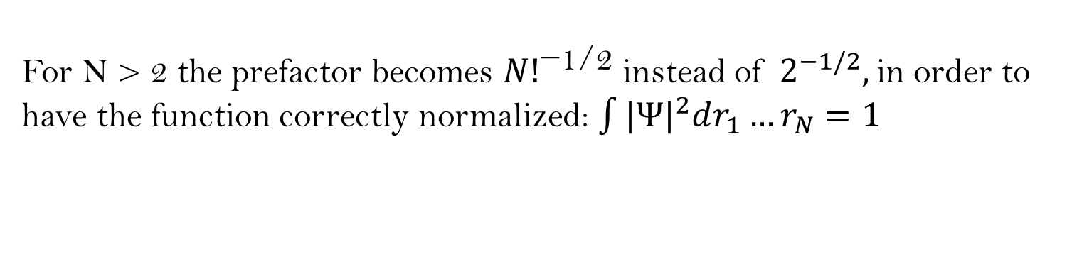
Exclusion principle
For N > 2 the prefactor becomes ${N!}^{\text{−1/2}}$instead of $2^{−1/2},$in order to have the function correctly normalized: $\int{|{Ψ|}^{2}dr_{1}}…r_{N}=1$
total energy
E = $\sum_{i}{ε_{i}}$
Summary
Electronic
Magnetic
Structure
electron charge density is

Slide 4


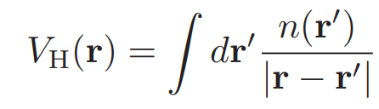
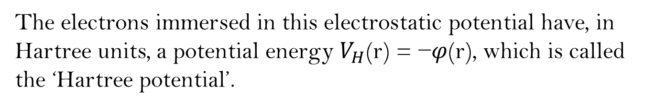
Mean-field approximation
A distribution of electronic charge, n(r) will generate an electrostatic potential ϕ(r) through Poisson’s equation:
The electrons immersed in this electrostatic potential have, in Hartree units, a potential energy $V_{H}$(r) = −$φ$(r), which is called the ‘Hartree potential’.
Summary
Magnetic
Structure
Electronic
The formal solution of this equation is:

Slide 5
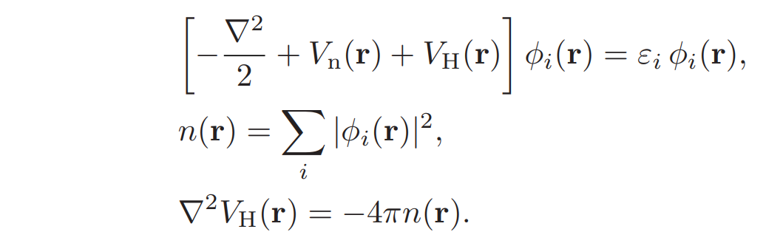
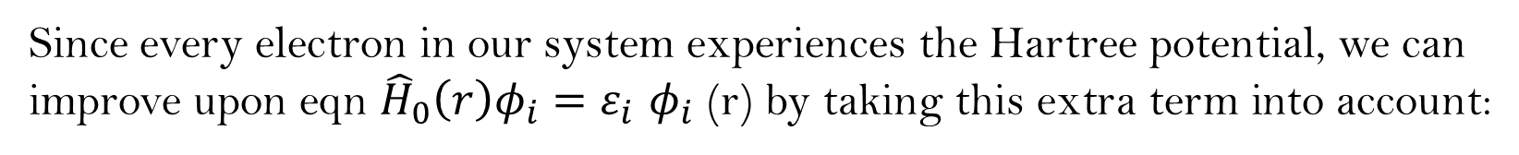
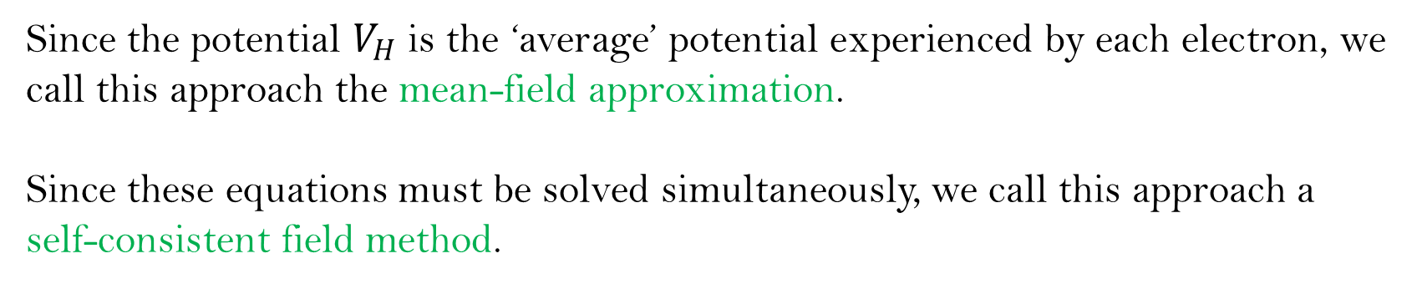
Mean-field approximation
Since every electron in our system experiences the Hartree potential, we can improve upon eqn ${\hat{H}}_{0}\left(r\right)φ_{i}=ε_{i}$ $φ_{i}$(r) by taking this extra term into account:
Summary
Magnetic
Structure
Electronic
Since the potential $V_{H}$ is the ‘average’ potential experienced by each electron, we call this approach the mean-field approximation.
Since these equations must be solved simultaneously, we call this approach a self-consistent field method.

Slide 6

Mean-field approximation
Equations in mean-field approximation represent a major simplification of our initial task of solving the complete many-body Schr$\ddot{o}$dinger equation , since one differential equation in 3N dimensions has been replaced by N(electron) three-dimensional equations.
If we go back to the example of silicon, we see that in this case the characteristic size of the arrays needed for describing the wavefunctions is N × $N_{p}$ ∼ ${10}^{5}(8 electron, 10000 points)$, instead of the previous ${10}^{46}$
However, this approximation is not accurate enough for a quantitative study of materials at the atomic scale.
We still need to add two ingredients: ‘exchange potential’ and the ‘correlation potential’.
Summary
Magnetic
Structure
Electronic

